Slide 1
Design Pipeline Options

Slide 2
Pipeline Design Option
This document presents the design options associated with implementing the Pipelines.
This entails which components to use and options traded-offs ie what to do where
Triggering alternatives will be investigated as part of orchestration.
Performance will be measured and documented.
The workspace used: Jse Trial Dev Network
Lakehouse Used:
Notes:
This is

Slide 3
Pipeline option 1: Orchestrate_Backtesting V1
This is the first pipeline, and is a simple Medallion implementation with manual orchestration.
So they entail 3 notebooks where the code is set up in 3 notebooks based on it running in the first notebook
These 3 notebooks are then attached to the Notebook components that are then
The Orchestration Pipeline consists of 2 pipelines encapsulates each in Invoke Pipeline Components
Pipeline Contract BT -1
Pipeline Contract BT – 1 Meta Data

Slide 4
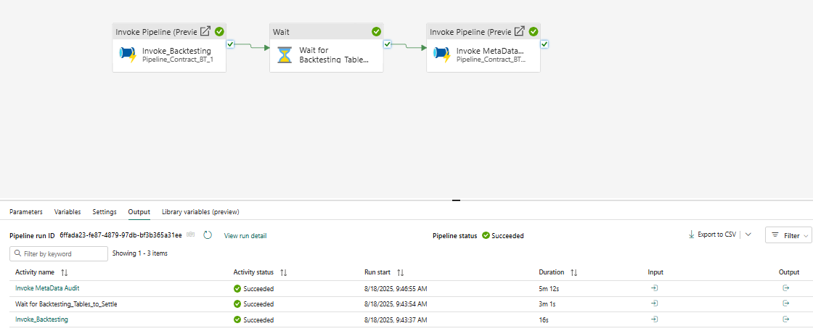
Pipeline: Orchestrate_Backtesting_V1
The pipeline is shown below , with the result of a successful run
Notes:
Note how long each component took to run , especially the metadata capture
The wait component is necessitated by the delay to instantiate the tables. This needs to be measured by more testing as it failed when no delay was included
This pipeline was triggered manually.
The invoke pipeline blocks trigger their underlying pipelines.

Slide 5
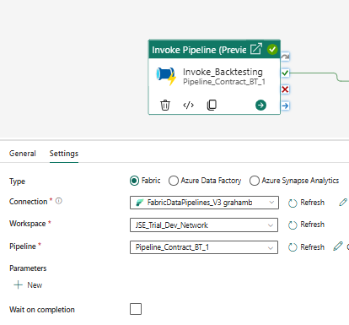
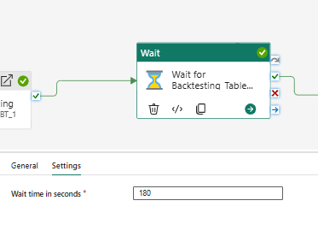
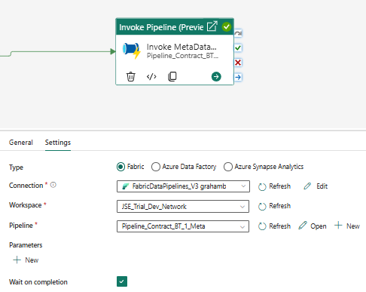
Components Settings Captured
Notes:
Note the wait on completion is set in the second pipeline but not in the first
Note where the pipelines are addressed in the first and 3rd Invoke blocks.

Slide 6
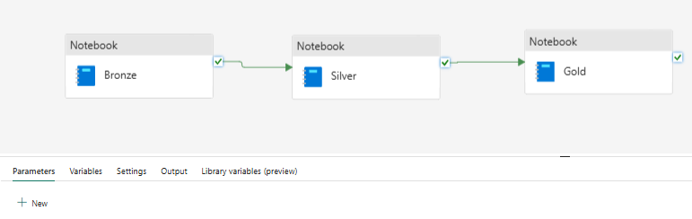
Pipeline_Contract_BT_1 (inside 1st Invoke block)
This is the underlying pipeline of the first Invoke Block of the previously discussed pipeline
There are no settings required for this pipeline as a whole , as its triggered by the invoke blocks
The settings of each component are set out on the following page.

Slide 7
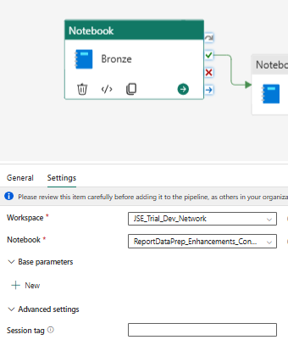
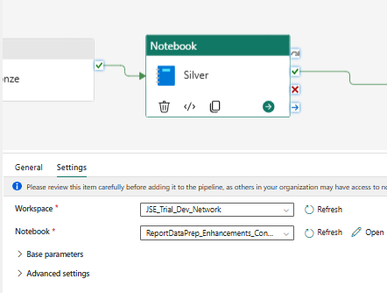
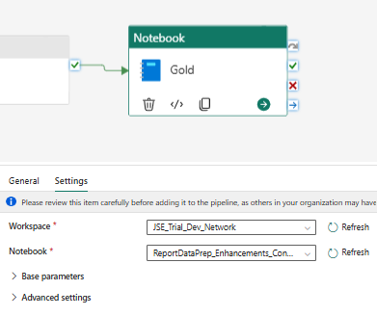
Component settings of each Block
ReportDataPrep_Enhancements_Contract_BT 1_Bronze
ReportDataPrep_Enhancements_Contract_BT 1_Silver
ReportDataPrep_Enhancements_Contract_BT 1_Gold
Notes:
Note the referral to the notebooks
They do not have folder paths, although the notebooks reside in a folder.
The notebook full names are listed underneath.

Slide 8
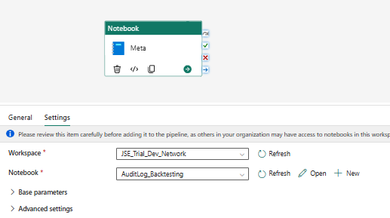
Pipeline: Contract BT1 with Meta
Notes:
1) Linked to Notebook: AuditLog_Backtesting

Slide 9
Note-books for Backtesting V1
Initially one notebook was used where all the stages in the medallion architecture were instantiated. This is mandatory to test the entire process of table instantiation in the appropriate schema. Only once this is run then the independent notebooks at each stage can be tested
The notebooks were then independently run to test
These notebook were then attached to pipeline components (next section) and the pipeline was manually run

Slide 10
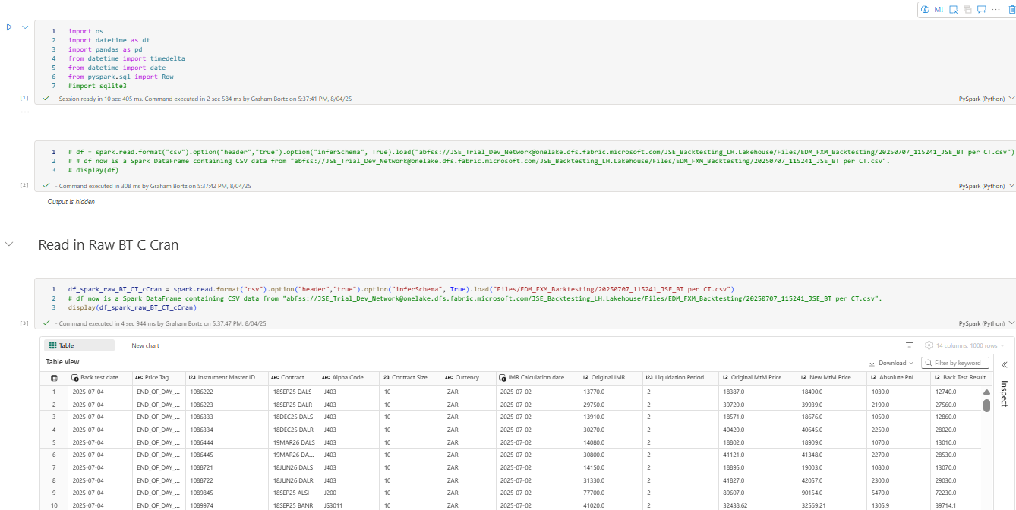
Full Notebook Part 1:
ReportDataPrep_Enhancements_Contract_BT 1_Complete
Notes:
Library instantiation
Reading the Bronze table and display in Raw CSV (20250707_115241_JSE_BT per CT.csv)

Slide 11
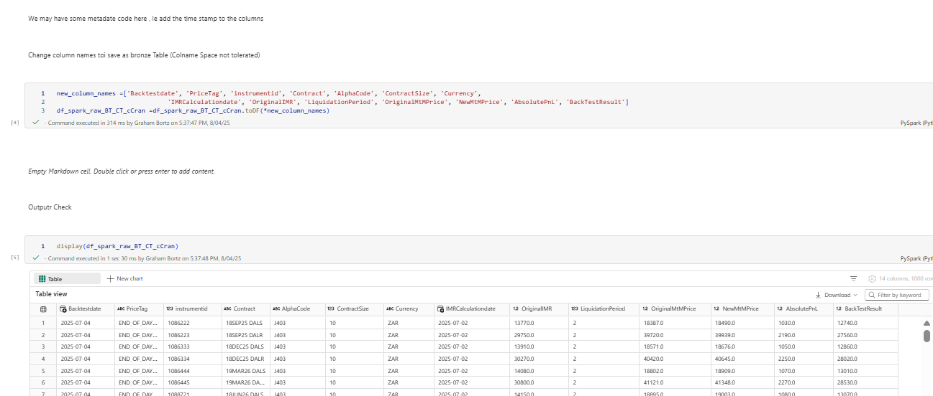
Full Notebook Part 2:
Notes:
Change column names (no spaces)
Check dataframe

Slide 12
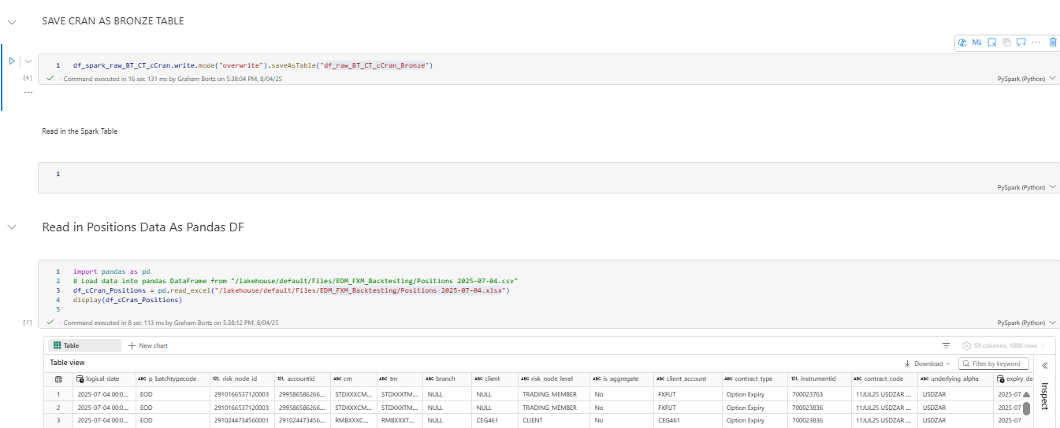
Full Notebook Part 3:
Notes:
Save as a Bronze Table : df_raw_BT_CT_cCran_Bronze
Read in the Positions Table and display ie an excel fil: EDM_FXM_Backtesting/Positions 2025-07-04.xlsx

Slide 13
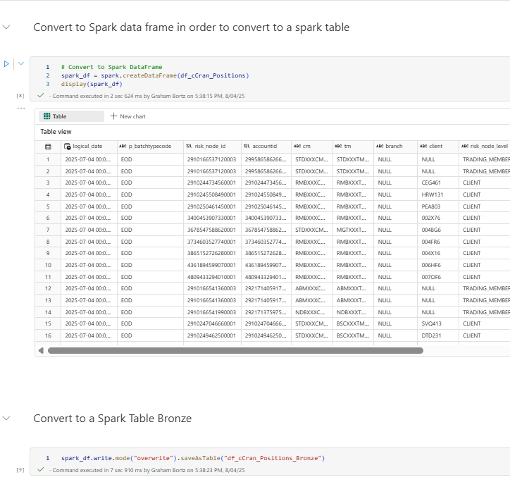
Full Notebook Part 4:
Notes:
Convert to Spark Dataframe
Convert to a Table in the schema

Slide 14
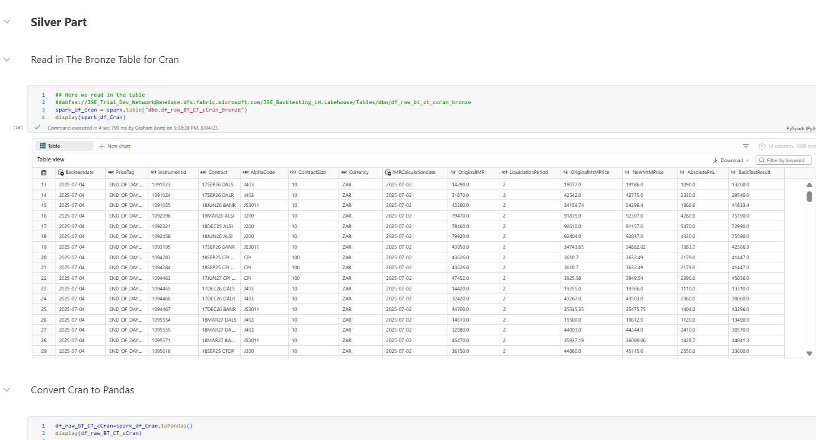
Complete Notebook Part 4
Notes:
Read in the Contracts Bronze Table into a Spark dataframe
Convert the spark to Pandas

Slide 15
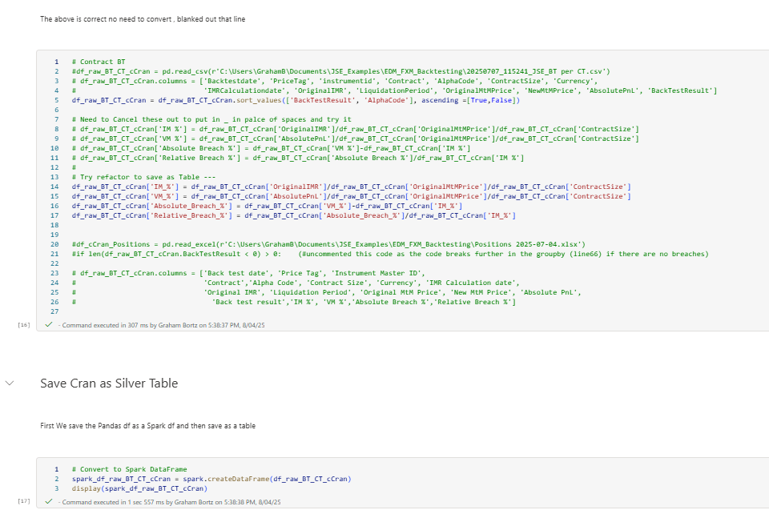
Complete Notebook Part 5
Notes:
Process From Bronze to Silver State (only column enrichment)
Save as Silver Table

Slide 16
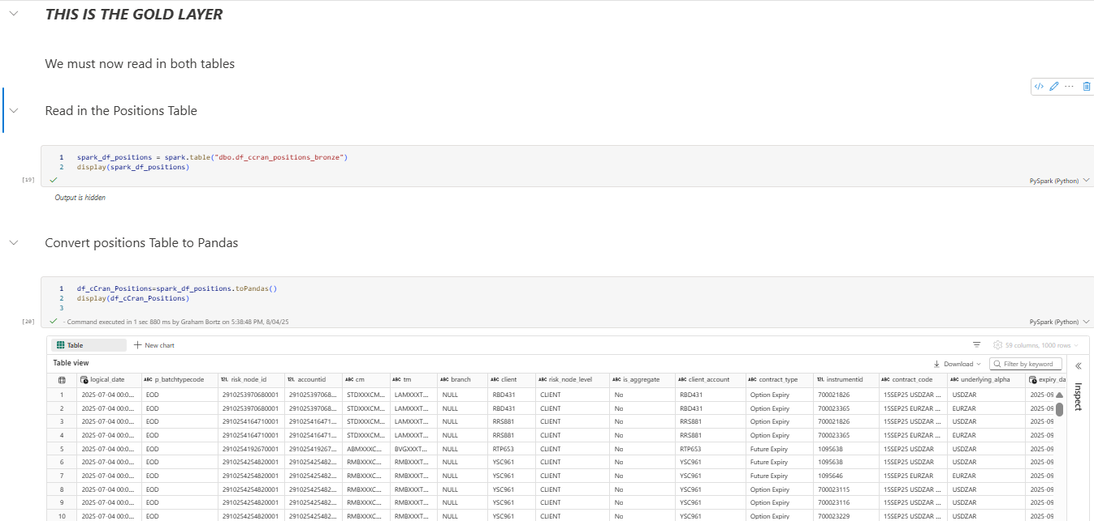
Complete Notebook Part 6
Notes:
Read in the Bronze Positions Table into a Spark df
Convert to Pandas

Slide 17
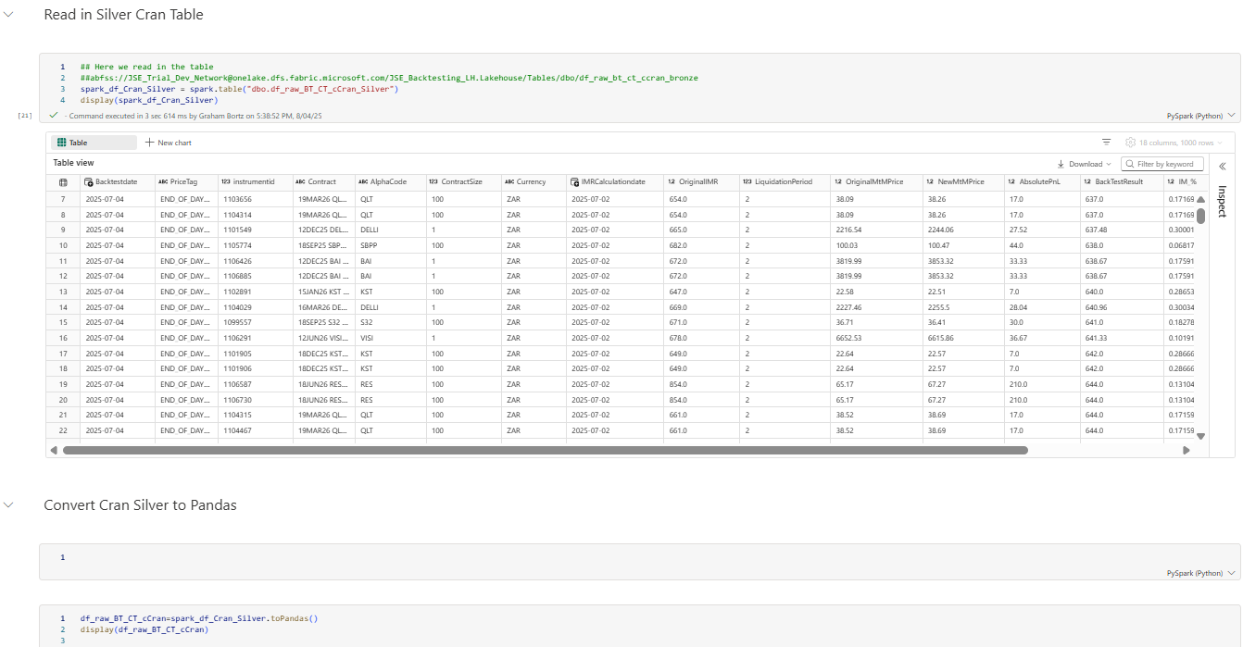
Complete Notebook Part 7
Notes:
Read in the Cran Silver Table
Convert to Pandas

Slide 18
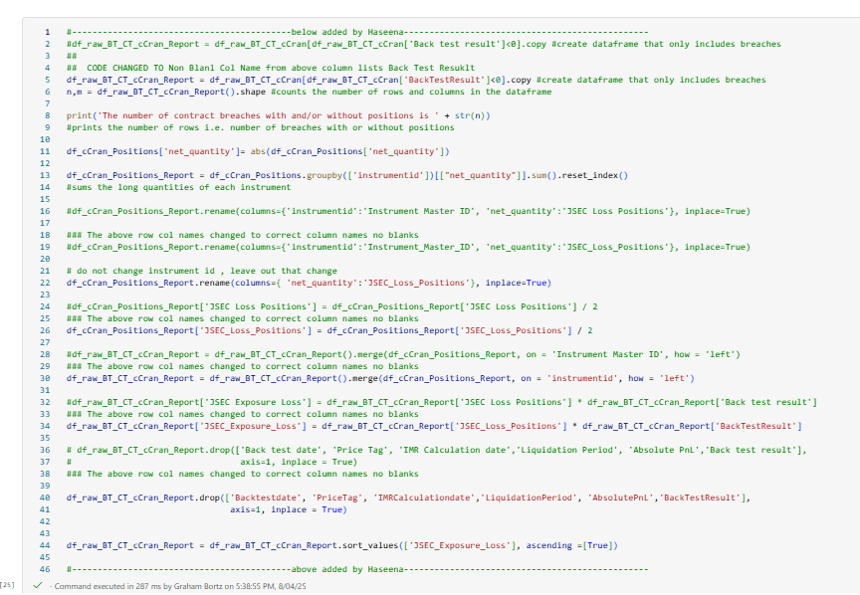
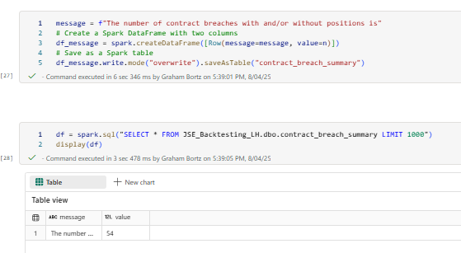
Complete Notebook Part 8
Notes:
Process to gold (Aggregation and Joins )
Print out resukts to a gold table

Slide 19
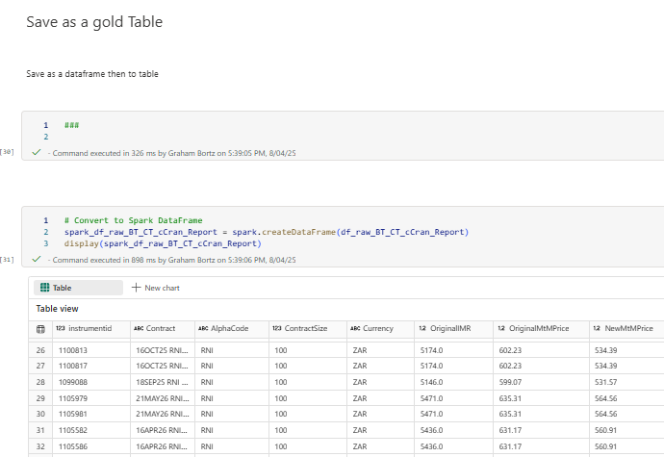
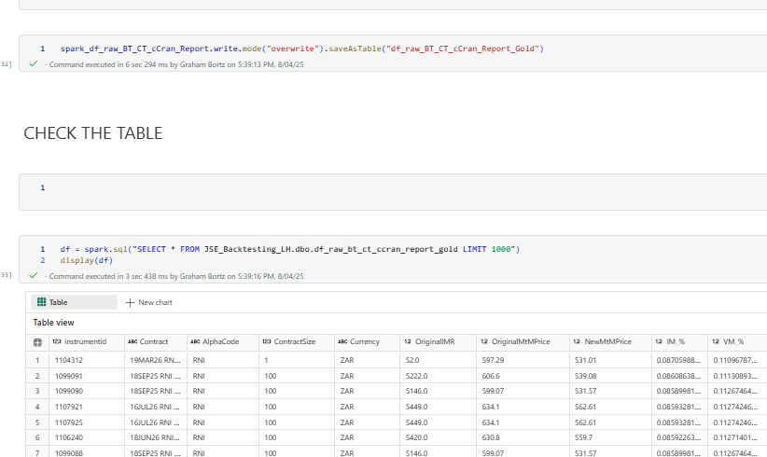
Complete Notebook Part 9
Notes:
Convert final table from Pandas to Spark
Save as a Gold table and Test

Slide 20
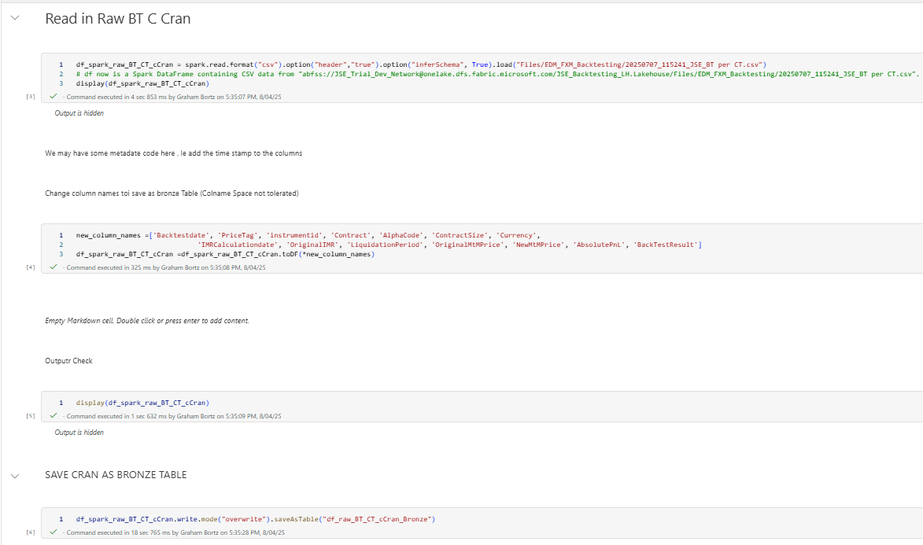
Notebook: ReportDataPrep_Enhancements_Contract_BT 1_Bronze (pg 1of 2)
Notes:
Note the outputs are hidden:
1) Read in Raw Cran Table from CSV
2) Rename the headings
3) Save as Bronze Table

Slide 21
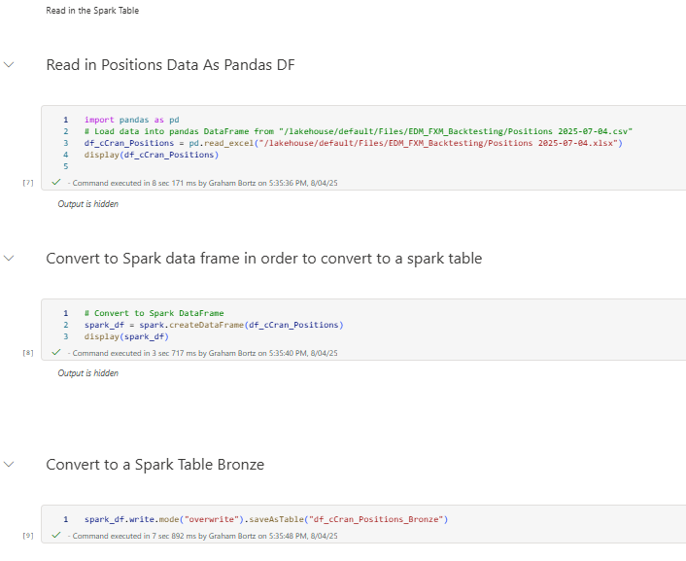
Notebook: ReportDataPrep_Enhancements_Contract_BT 1_Bronze (pg 2 of 2)
Notes:
Read in positions Data as a Pandas dataframe
Convert to a Spark Dataframe
Convert to a Bronze Table
End of Bronze

Slide 22
End of Bronze Layer

Slide 23
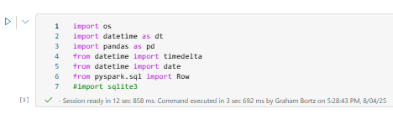
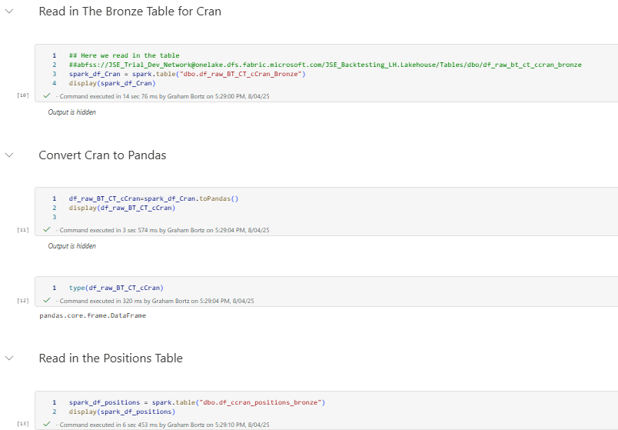
ReportDataPrep_Enhancements_Contract_BT 1_Silver (Pg 1 of 2 )
Notes:
Import Library
Read in the Cran Table from Bronze
Convert Cran to Pandas
Read in the Positions Table From Bronze

Slide 24
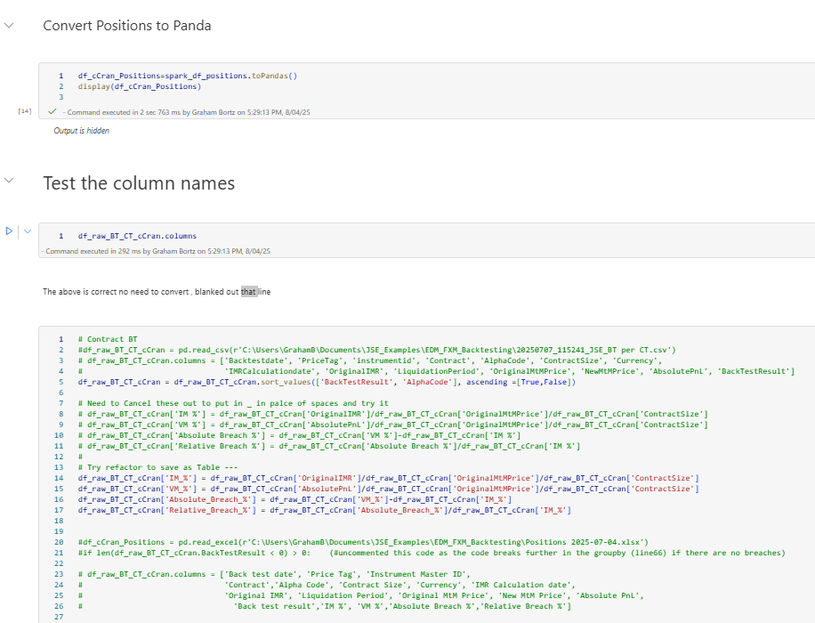
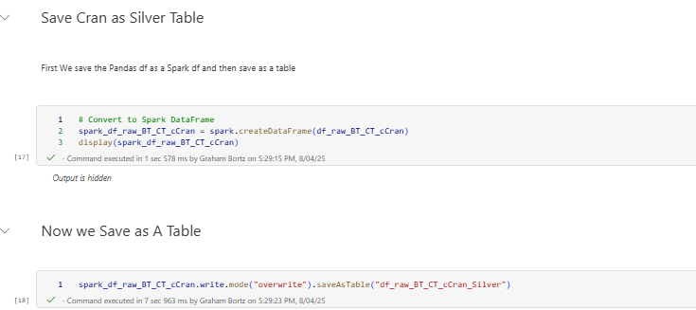
ReportDataPrep_Enhancements_Contract_BT 1_Silver (Pg 2 of 2 )
Notes:
Convert Positions to Pandas
Process to Silver
Convert to Spark
Save As a Table

Slide 26
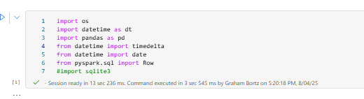
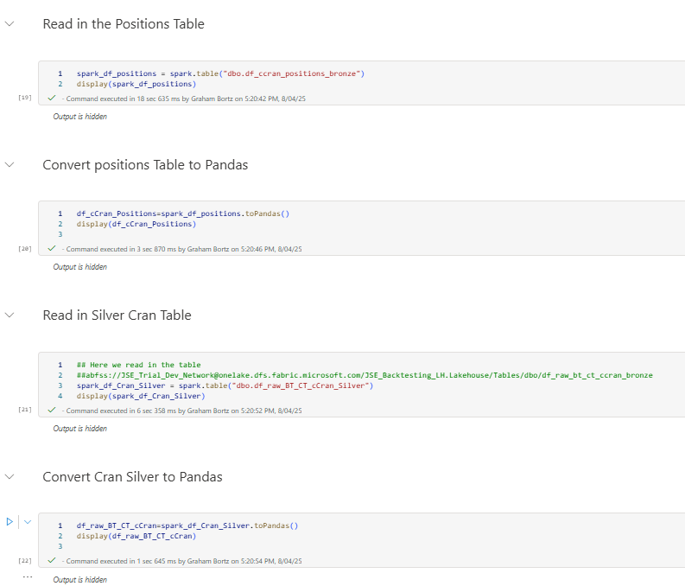
ReportDataPrep_Enhancements_Contract_BT 1_Gold pg 1 of 3
Notes:
Import Libraries
Read in the Positions Table (from Bronze Layer)
Convert to Pandas
Read in Cran Silver Table
Convert Cran Silver to Pandas

Slide 27
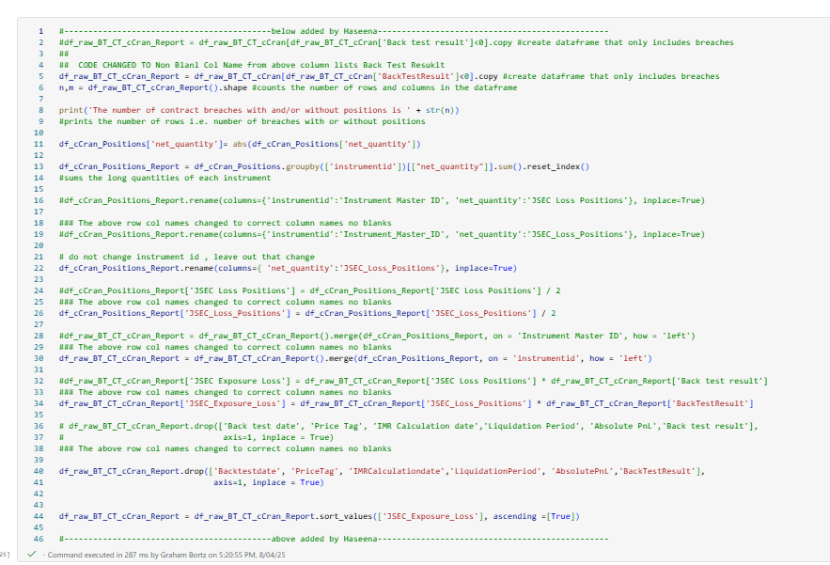
ReportDataPrep_Enhancements_Contract_BT 1_Gold pg 2 of 3
Notes:
1) Process to Gold Pandas Frame

Slide 28
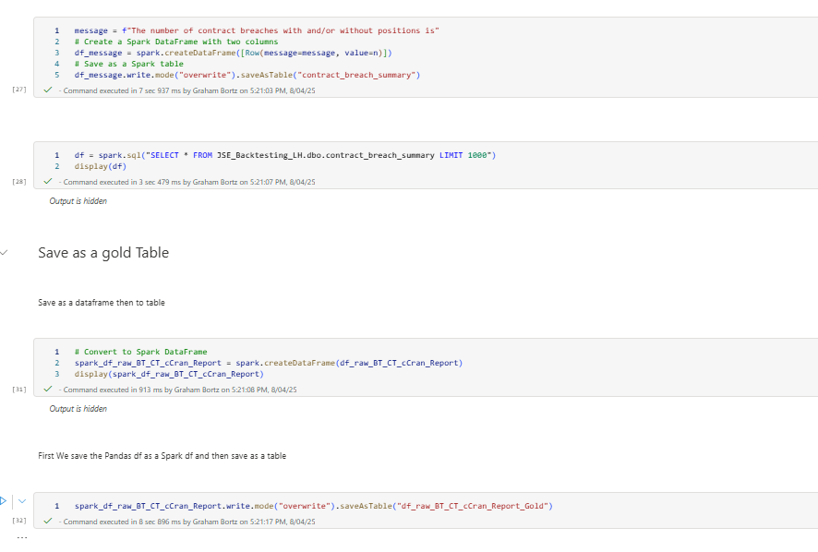
ReportDataPrep_Enhancements_Contract_BT 1_Gold pg 3 of 3
Notes:
Save results to a Table
Save the Gold processed frame to a dataframe
Save the Dataframe to a Gold Table

Slide 29
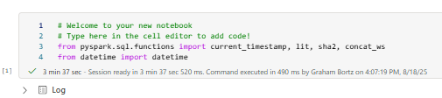
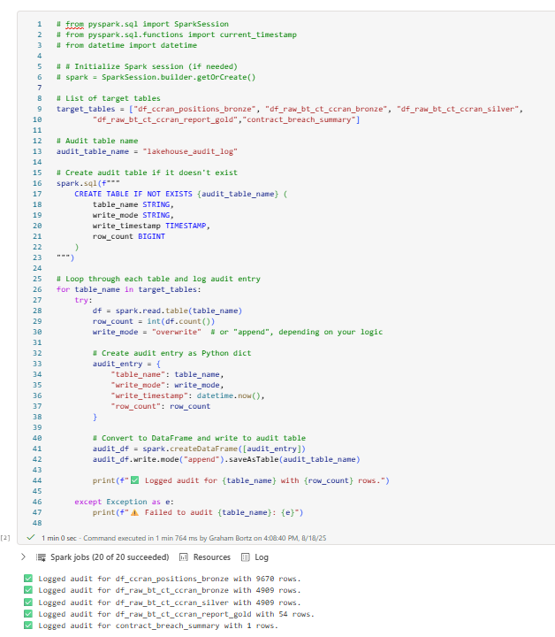
Notebook: AuditLog_Backtesting pg 1 of 2
Notes:
Libraries
Audit log creation

Slide 30
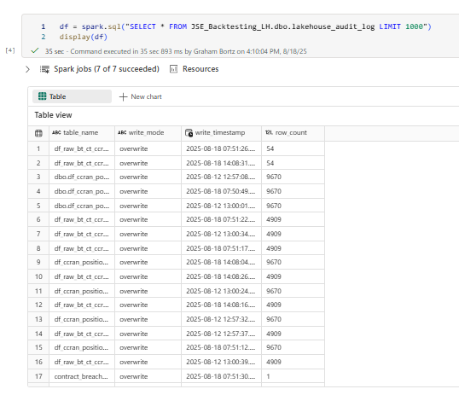
Check the Table

Slide 31
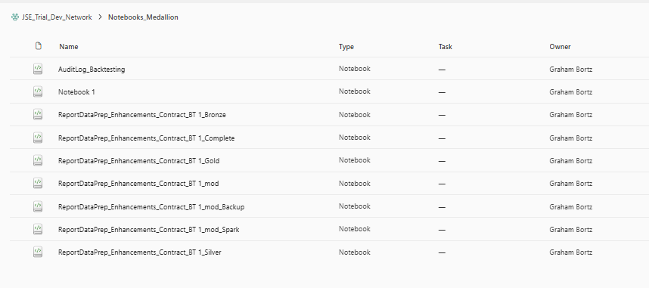
Notebooks in Folder

Slide 32
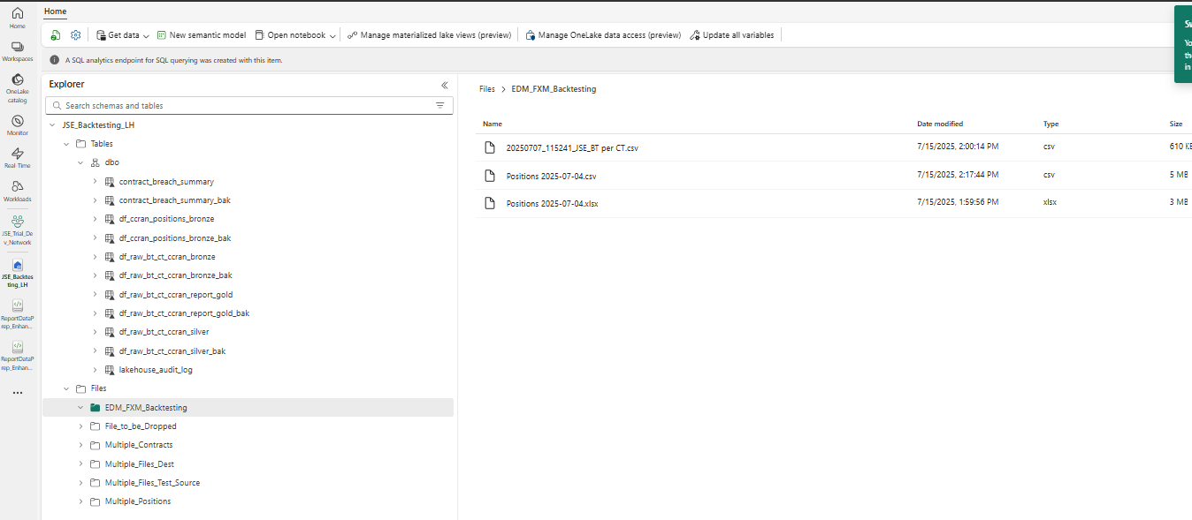
Tables and files in Lakehouse

Slide 33
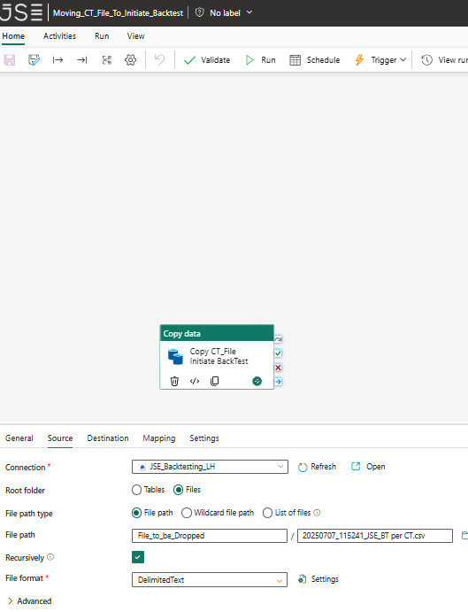
Trigger Backtesting Pipeline Above by File Drop : Any File Drop Pipeline name :Orchestrate backtesting V2 With Trigger Move Pipeline : Moving_CT_File_To_Initiate_Backtest
Notes:
Trigered by dropping the file into the Folder
The file: 20250707_115241_JSE_BT per CT.csv was dropped into folder (EDM_FXM_Backtesting)via a copy command
The Move Pipelile

Slide 34
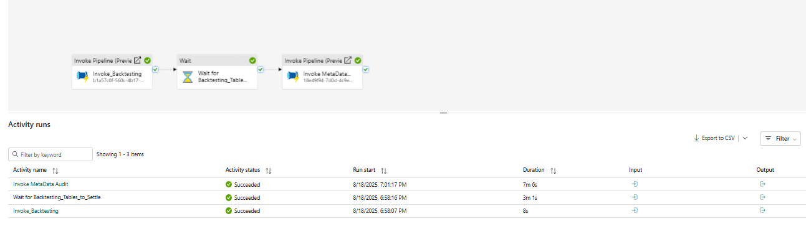
The Pipeline : Ran successfully Orchestrate_BackTesting_V2_wTrigger

Slide 35
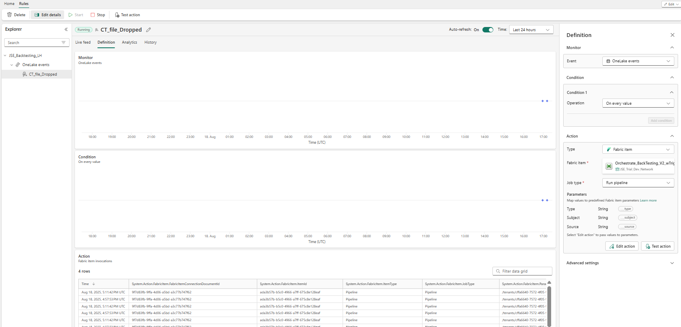
The Activator : CT_file_Drop was used to triggerthe pipeline and the dashboard wirth config on the righ tis shown below

Slide 36
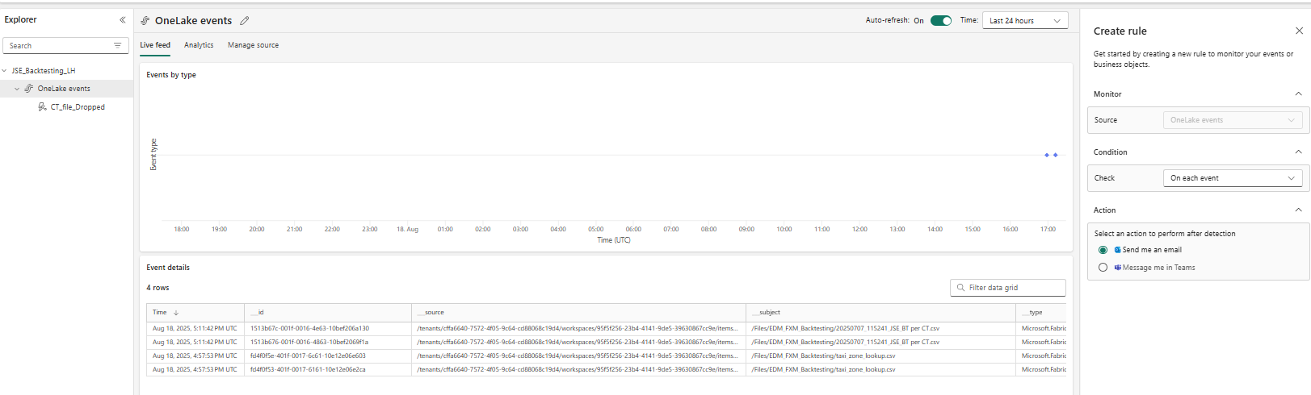
One lake events

Slide 37
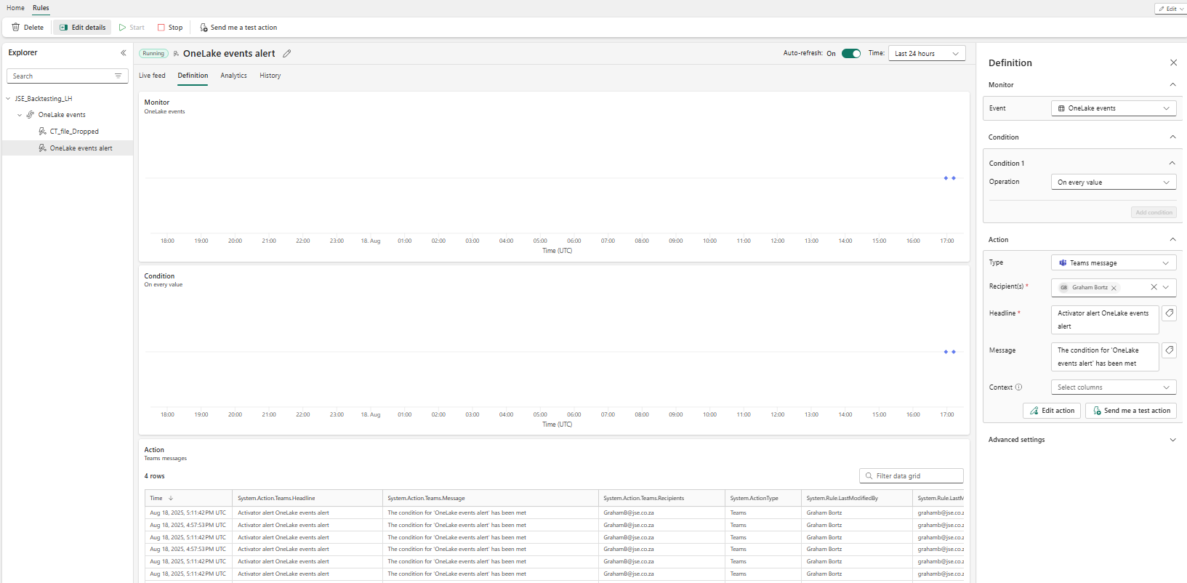
We now create a rule to send streams message

Slide 38
Method
With Backtesting , we need to check for presence of Both files
We will identify the logic of the test prior to the initiation of the Backtest algorithm
The logic had parameters that take in the filenames but these filenames are fixed in the notebooks. The Notebooks must be parameterized.
At present we have to test the email functionality if only 1 of the 2 files are present or both are not present.

Slide 39
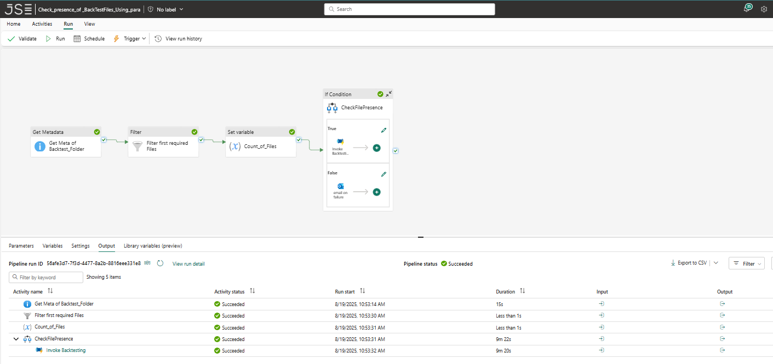
Pipeline is called : Check_presence_of _BackTestFiles_Using_para
Notes:
Here is the pipeline and here is the run , successful

Slide 40
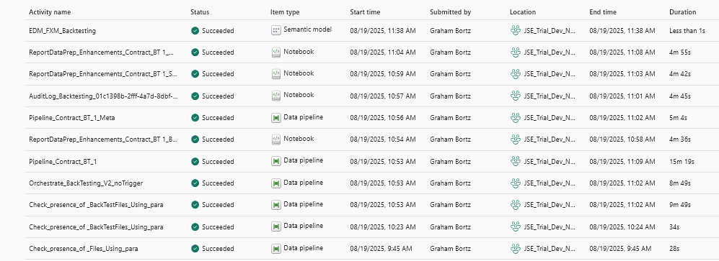
Looking at the monitor – to see the execution times in more details
Notes:
Note how audit backlog , initiates prior to gold.

Slide 41
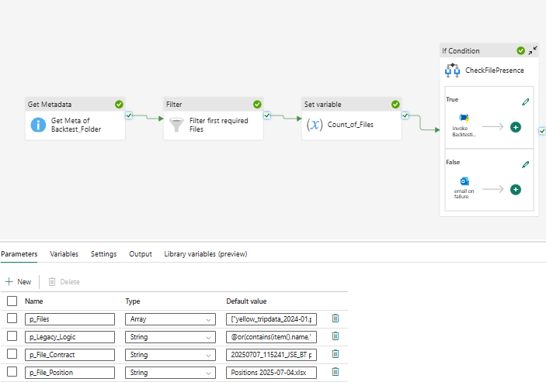
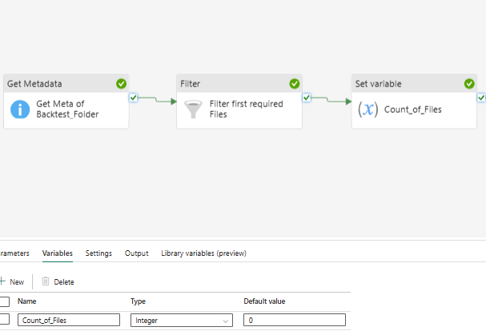
Settings of Each Block – that achieved the results above, see parameters
Notes:
Notes the parameter settings: especially p_File_Contract and p_File_Position which are inputs
Also note the variables settings on the right ..for the Count of the files : Count_of_Files

Slide 42
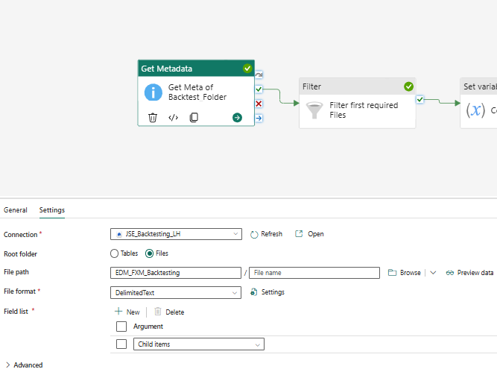
Get Meta data Block Settings
Notes:
Note the folders and its set to child items

Slide 43
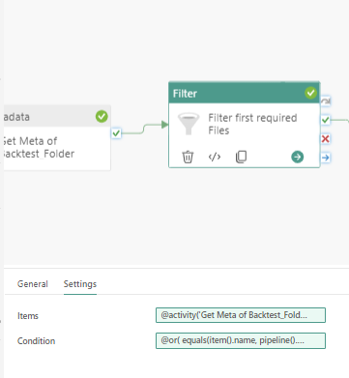
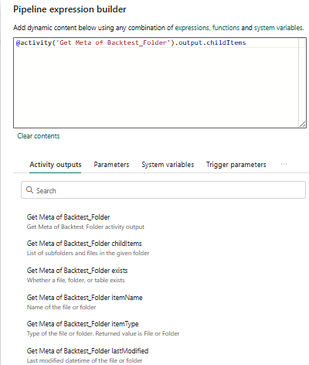
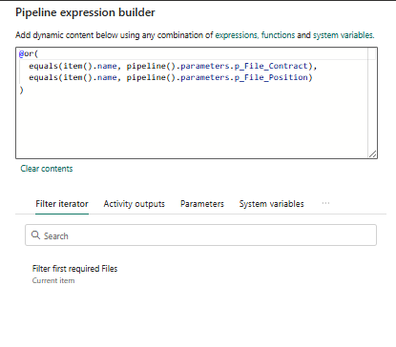
Filter Settings – Expression builder items on left and Condition on the right
Notes:
Chose ‘child items option’ for the items : @activity('Get Meta of Backtest_Folder').output.childItems
Note the or function for the expression : @or(
equals(item().name, pipeline().parameters.p_File_Contract),
equals(item().name, pipeline().parameters.p_File_Position)
)

Slide 44
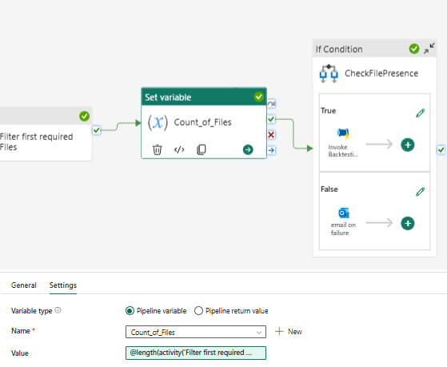

Count of Files Block
Notes:
The Name Count_of_Files , can be used as it was set as part of Pipeline variables Not parameters.
See the expression to get the count using the length expression : @length(activity('Filter first required Files').output.Value)
Note the use of .Value to get the crrect array. The filter output is more than the Value array.

Slide 45


If condition Parent variables (note the 2 choices in the activities ), based on the output of the expressioin, see notes below
Notes:
The if condition is in the expression : @equals(variables('Count_of_Files'),2)

Slide 46


Go into the separate activities for the if conmdition ie grab the pencil for each
True activity
False activity
Notes:
See the settings for the 2 conditions (+ve , left and –ve right)
The left side invokes the pOrchestrate Backtesting V2 no trgigger pipeline, which is similar to that discussed in the first solution , without the trigger mecahism. The setrtting for this pipeline remain the same , except has no auto trigeer
We are going to try to trigger this pipeline with the Contracts file , and let the system wait 3 minutes foir the other file , before it
Note you must set up a connection. This was set up previously
The email you must sign in , and then you cant use the dynamic content list which comes upo with a click in the email content as shown above

Slide 47
Tasks – improve product.
Try delete file and test the email,
Try get the if statement to identify the missing file
Try put in any files in the parametres , and parameterize the notebooks , so that it can do for any position/contract pair.
Do the power bi
Try do multiple months 1,2,3 , by using the dataflow. Initially with the fixed 3 files , and then 3 to 5 files if possible
Also automate
1) via a trigger on one file with a delay for the other , - also with the error
2) via schedule but with a check of the input files
Implement more variables in the email.
Try implement incremental refresh, for tables that expand.

